Slide 1
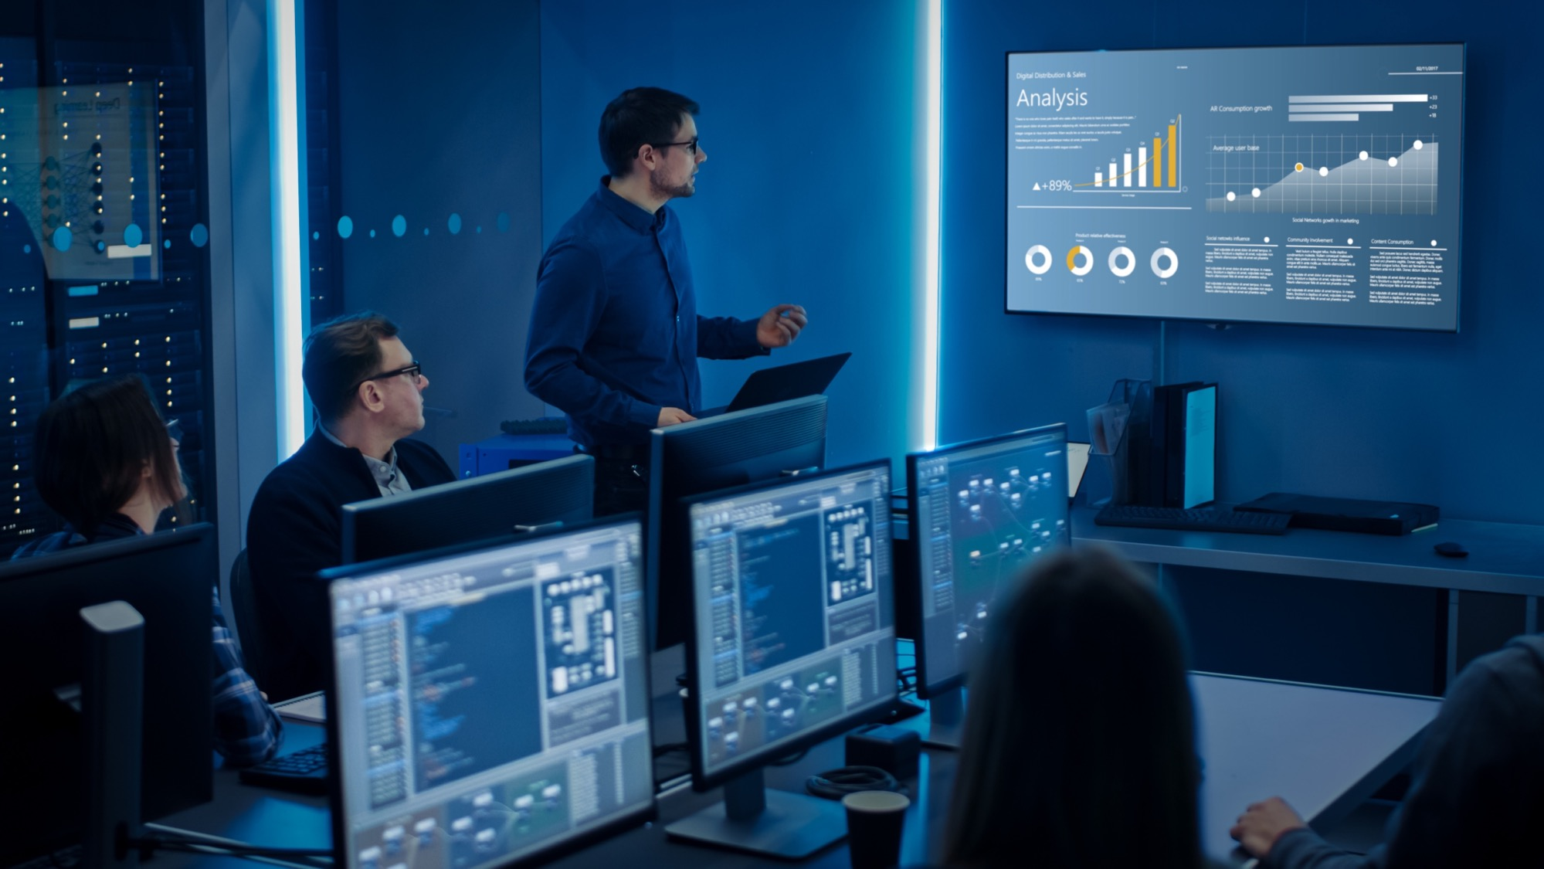

How Observability empowers Quality Engineers to build reliable systems
TESTINGMIND
May 2024
Sai Sivasailem, LTIMindtree

Slide 2
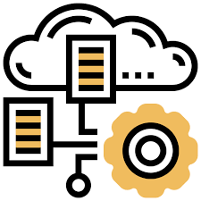
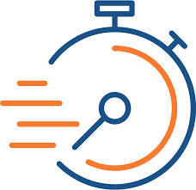

Application Landscape is getting complex
88%
> 60 minutes
$150K / hr
of technology leaders say the complexity of their tech stack has increased in the past 12 months
82% of organizations reported that mean time to recovery (MTTR) is taking over an hour & increasing Y-O-Y up from 74% in 2023
Downtimes are expensive. Average downtime hourly cost for nearly two-thirds of orgs
Notes:
References:
https://www.apmdigest.com/challenges-and-trends-in-observability-adoption-2024
Dynatrace - The state of observability 2024
Splunk - state-of-observability-2023

Slide 3

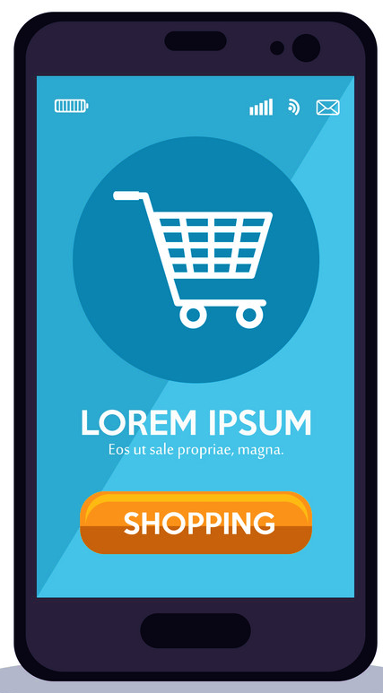





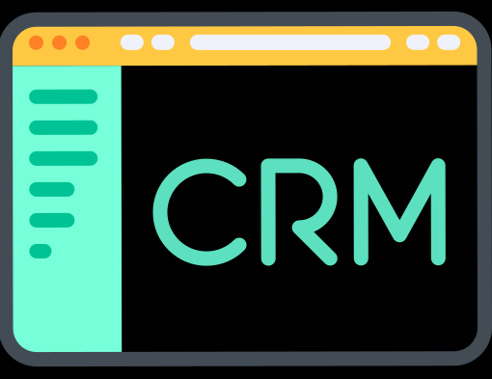


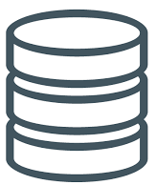
Monolithic apps are becoming Legacies…
Web App
API
Built as single entity
Tightly coupled
Entire application to be rebuilt and deployed
Slower Release Velocity
Vertical Scaling up
Modules
Monolithic Server Process
Customer
Order
Cart
Payments
Files
Downstream systems
Upstream systems
Address
Catalog
Relational Database
Notes:
is an approach to developing a single application as a suite of small services, each running in its own process and communicating with lightweight mechanisms, often an HTTP resource API. These services are built around business capabilities and independently deployable by fully automated deployment machinery.

Slide 4
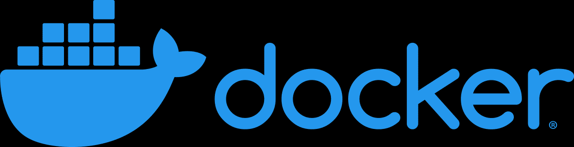





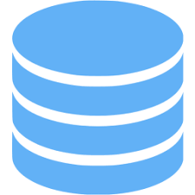

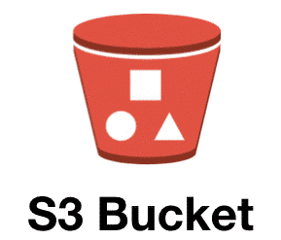


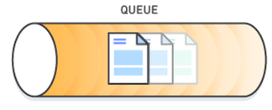

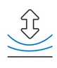


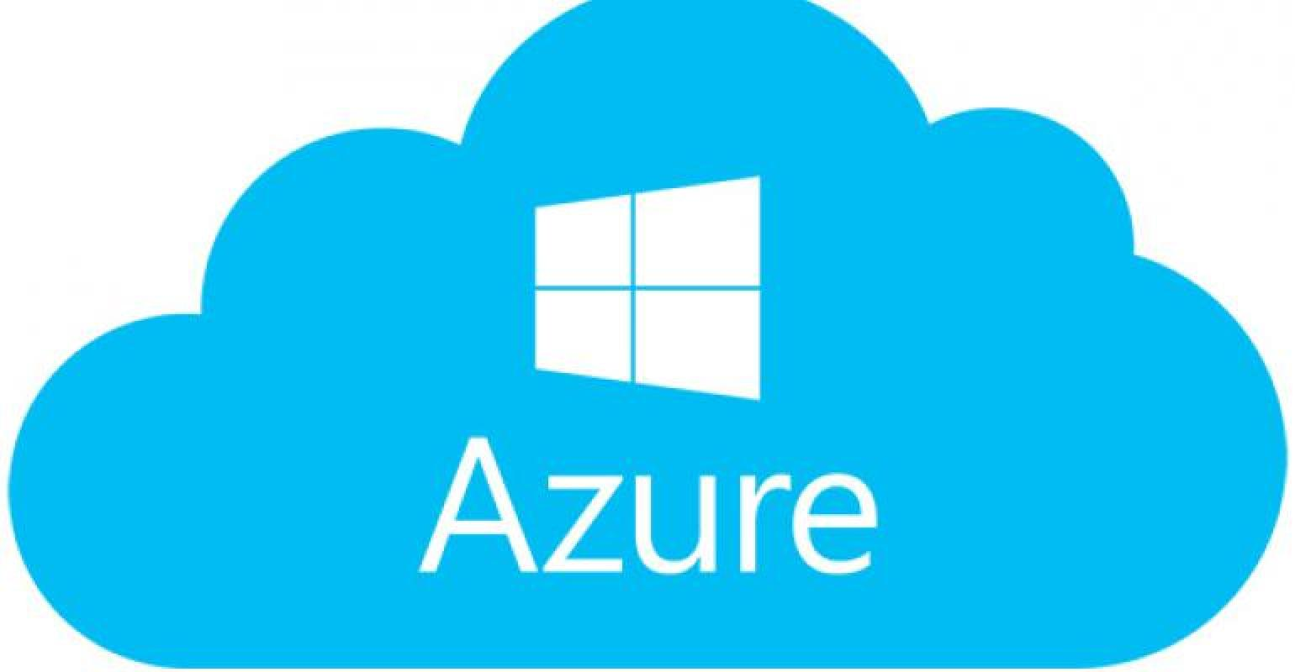
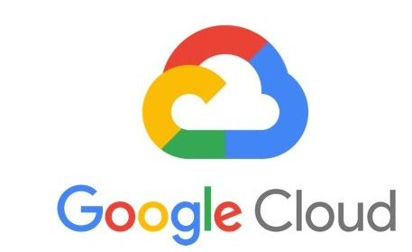
Businesses modernize application stack to stay competitive
Cloud native is an architectural approach to build applications as microservices, package as containers and deploy them in cloud platforms that fully exploits the advantages of the cloud capabilities
BFF Layer
Service code, DB & dependencies packaged & deployed as Containers
Suite of Microservices bounded by Business context
Polyglot & Loosely coupled adhered through contracts
Self-contained & Packaged as Containers
Independently deployable & scalable
Managed by Container Orchestration systems like K8s
Hybrid and Multi-Cloud deployments
API Gateway
HTTP
Files
Transformation
Relational
Data Store
Customer Microservice
Order Microservice
Cart Microservice
Payments Microservice
MQ
HTTP
HTTP
Accelerate release velocity
MQ
Autonomous Releases
Upstream systems
Relational
Downstream systems
Address Microservice
Catalog Microservice
Resilient Applications

Slide 5





QA Imperatives with Cloud Native systems
Increased number of Services makes integration setup and E2E tests complex
Complex
Environments
Data Synchronization
Validating data consistencies across varied data sources and different services
Inter-service Communication results in Performance bottlenecks / network latencies and inability to isolate faults quickly
Performance Issues
QA Imperatives
Async
Processes
Async processes have broken Black Box Testing
With distributed deployments, the failure points are now multifold resulting in high MTTD/MTTR
Failure Points
Distributed Teams
Service development across different teams & diverse technology stacks create information barriers and makes issue resolutions complicated

Slide 6

Observable Systems

Slide 7
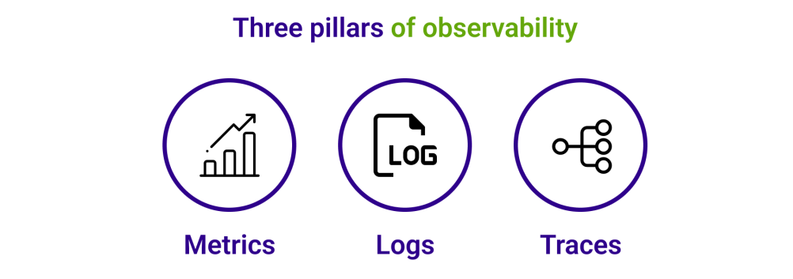

What is Observability?
Observability is the extent to which you can understand the internal state or condition of a complex system based only on knowledge of its external outputs.
Metrics: Quantitative measurements about processes and infrastructure over an interval of time to identify trends, spikes, or anomalies. E.g.,CPU Utilization %, Disk I/O operations
Logs: Timestamped event messages – structured / unstructured – emitted by services or other components to troubleshoot/debug
Traces: represents the end-to-end journey of a request through a distributed system to provide visibility of application behavior
Application code needs to be instrumented to emit signals such as traces, metrics, and logs
Notes:
https://orienteed.com/en/what-is-observability/

Slide 8
The Need for Observable Systems
BFF Layer
Web User Journey:
Login as customer -> Verify Address-> Catalog -> Add Cart -> Place Order -> Payment
Service code, DB & dependencies packaged & deployed as Containers
API Gateway
Mobile User Journey:
Login as guest -> Catalog -> Add Cart
HTTP
Files
Tracing application requests as they flow from frontend systems to backend services and databases
Propagates through multi-service architectures, like microservice and serverless applications.
Enables to troubleshoot components that exhibit high latency or errors
Transformation
Relational
Data Store
Customer Microservice
Order Microservice
Cart Microservice
Payments Microservice
MQ
HTTP
HTTP
Upstream systems
MQ
Relational
Downstream systems
Address Microservice
Catalog Microservice
Notes:
is an approach to developing a single application as a suite of small services, each running in its own process and communicating with lightweight mechanisms, often an HTTP resource API. These services are built around business capabilities and independently deployable by fully automated deployment machinery.

Slide 9
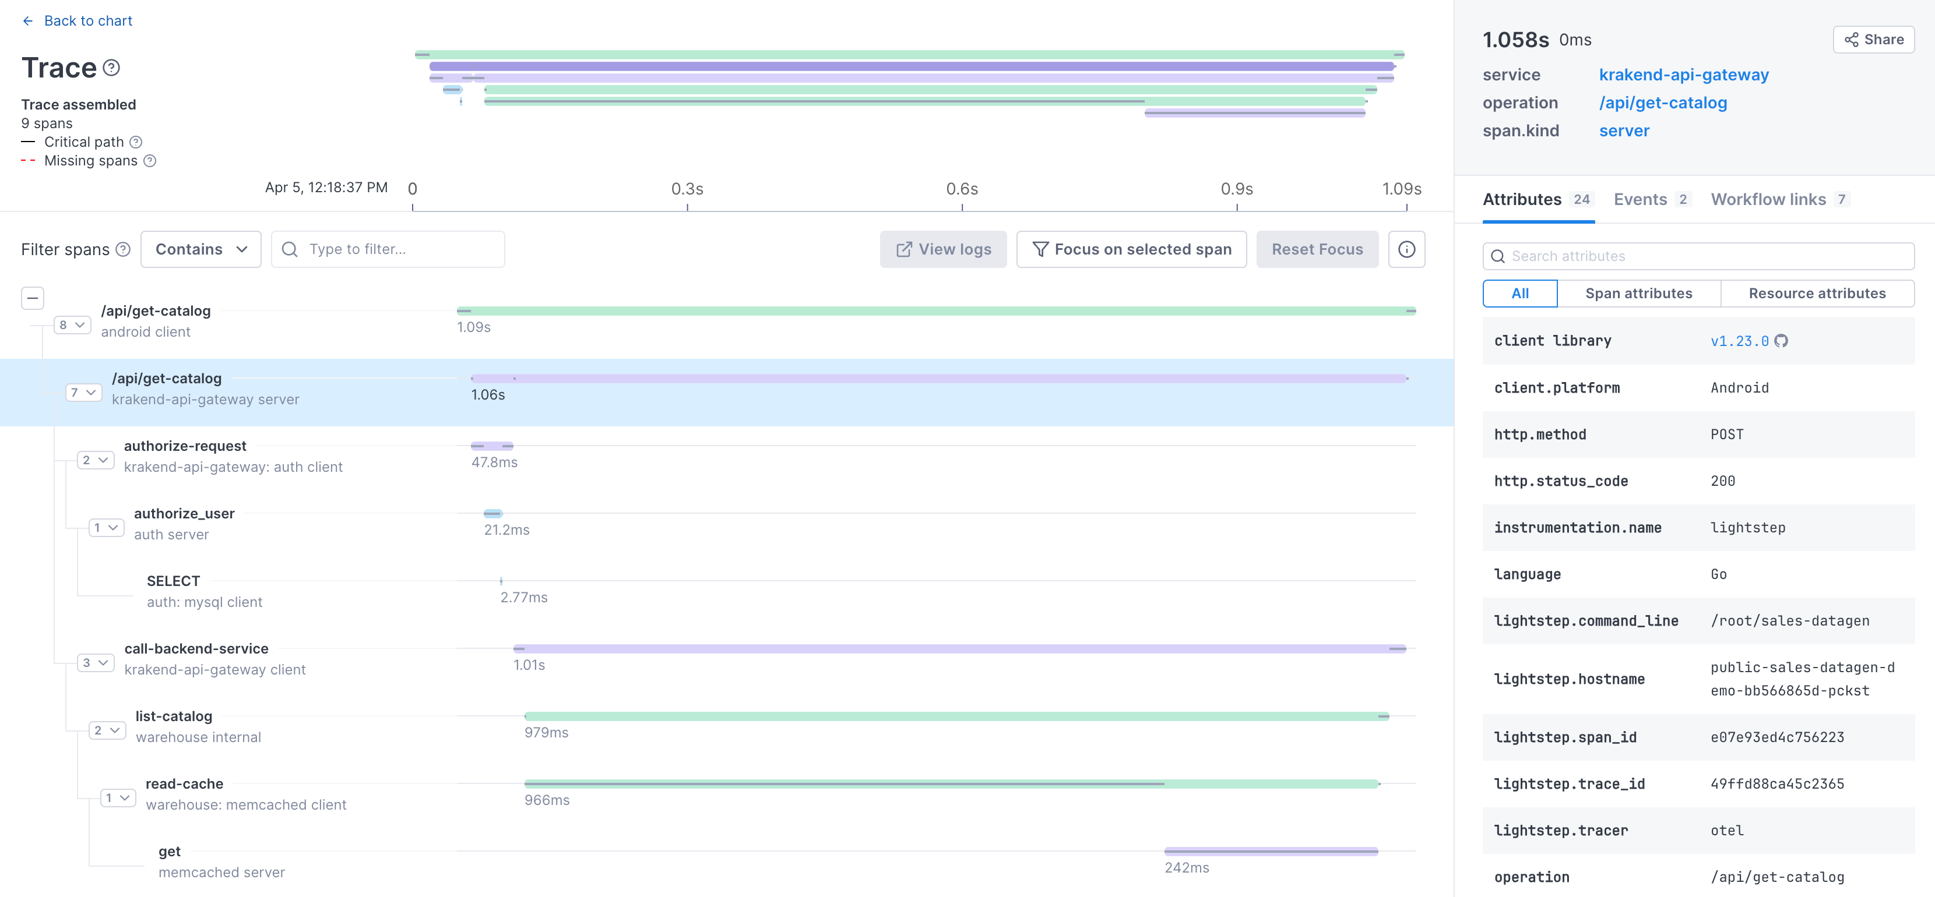
Deep dive on Distributed Tracing
Trace
Trace is made of one or more spans
Span represents a unit of work or operation (like DB query, API call etc.,)
Attributes are key-value pairs that contain span / resource metadata
Attributes
Context Propagation: Spans correlated with each other and assembled into a trace
Context Propagation
Spans
Waterfall Chart - Distributed Tracing

Slide 10
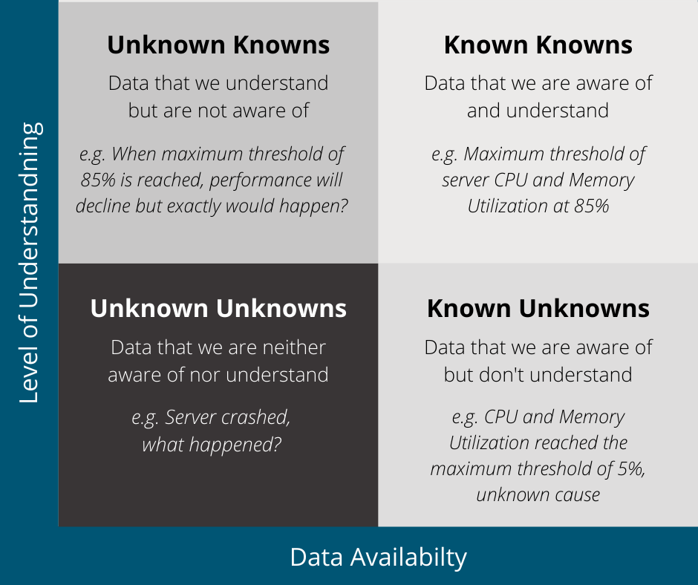
But we already have monitoring systems in place…
Observability helps detect, investigate and resolve the unknown unknowns
Monitoring helps engineers understand system-level concerns, while Observability for application-level concerns.
Observability
Source: https://www.itconductor.com/blog/how-to-build-observable-systems

Slide 11
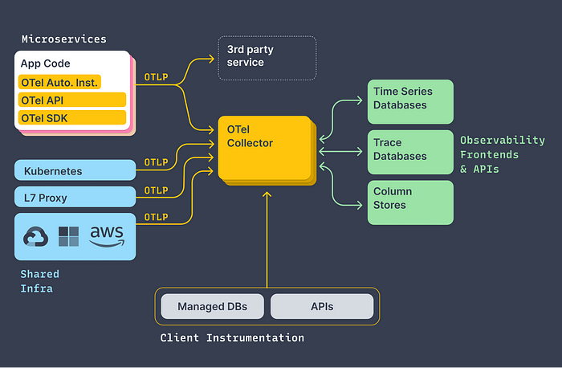

OpenTelemetry – Observability Framework
OpenTelemetry is an Open-Source observability framework for Cloud Native software
OTel Library - API / SDK:
Code Instrumentation for popular languages like Java, .NET, GO, Python etc., to enable tracing
Supports auto-instrumentation (for specific languages) and manual instrumentation by importing API and SDK to your service code
OTel Collector offers a vendor-agnostic implementation on how to collect, receive, process, and export telemetry data (Metrics, Log and Traces) to observability back-ends of your choice
OpenTelemetry Protocol (OTLP) specification describes the encoding, transport, and delivery mechanism of telemetry data
Notes:
Offers a vendor-agnostic implementation on how to collect, receive, process, and export telemetry data (Metrics, Log and Traces)
Export telemetry data to observability back-ends of your choice both open source like SigNoz, Jaeger or vendor specific backends like Splunk, Datadog etc.,

Slide 12

Observability Driven Testing

Slide 13





How can QA leverage these rich Observability data
Identify testing gaps & Improve test coverage
Remediate performance issues
Enable faster feedback loops
Baseline application current behavior
Proactive issue identification
Only 9% of applications are fully instrumented for end-to-end observability*
Enterprises with Observability are 4x as likely to resolve instances of unplanned downtime or serious service issues in just minutes, versus hours or days**
* Dynatrace – State of the Observability report 2024
** Splunk Observability report 2023

Slide 14

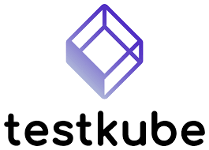







New age Observability and Cloud Native Testing tools
Trace-based testing leverages traces to allow tests to be run against distributed systems.
Write assertions against the data both in the response and distributed trace
Isolate performance latencies at the service level
Kubernetes-native testing framework / platforms
Performance Testing
Chaos Engineering
Microservices Contract Testing

Slide 15
Take aways…
Redefine Quality Engineering Strategy with Observability principles
Shift Left with Observability driven development
Start incremental observability e.g., every Pull Request, Critical business transactions

Slide 16

Q&A
https://www.linkedin.com/in/saisivasailem/

